Slide 1
Analyzing the Demographic Diversity of Volunteer Participation in AmeriCorps
DATS 6101, Group 8
Aidan Carlisle | Sayan Patra | Rachel Thomas | Anusha Umashankar

Slide 2

What is AmeriCorps?
US Federal agency that “brings people together to tacke the country’s most pressing challenges through national service and volunteering.”
AmeriCorps
AmeriCorps NCCC
AmeriCorps State and National
Public Health AmeriCorps
AmeriCorps VISTA
AmeriCorps Seniors
Foster Granparent Program
RSVP
Senior Companion Program
Senior Demonstration Program

Slide 3
Where is the data from?
Collected and published by AmeriCorps
Provides comparisons of demographic group prevalence in AmeriCorps Member/Volunteers populations to the greater U.S. population
The source dataset consists of about 26000 observations over 17 attributes

Slide 4
Proposed SMART Questions
Which program offices are most effective in engaging a diverse range of participants?
How does the representation of different demographic groups compare to their proportions in the general population?
Which groups are overrepresented or underrepresented in AmeriCorps?
How do participation rates compare between different programs within the same service region?
What is the racial composition of the volunteers?
Are some racial groups more engaged in volunteer activities within specific states?

Slide 5
Important note on MSYs
For member data, member service years [MSYs] (i.e., the number of days or hours members are required to serve over the course of their term to fulfill their service requirements) are summed and used in place of observed member counts to account for potential differences in service time allotments assigned to different demographic groups.

Slide 6
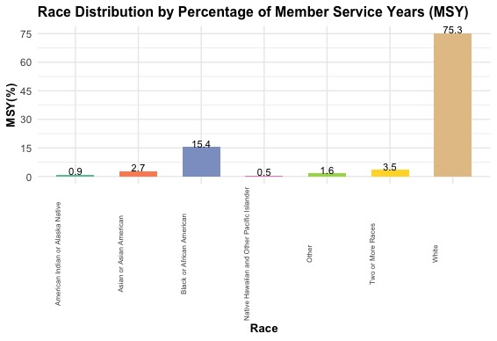
What is the racial composition of the volunteers?

Slide 7
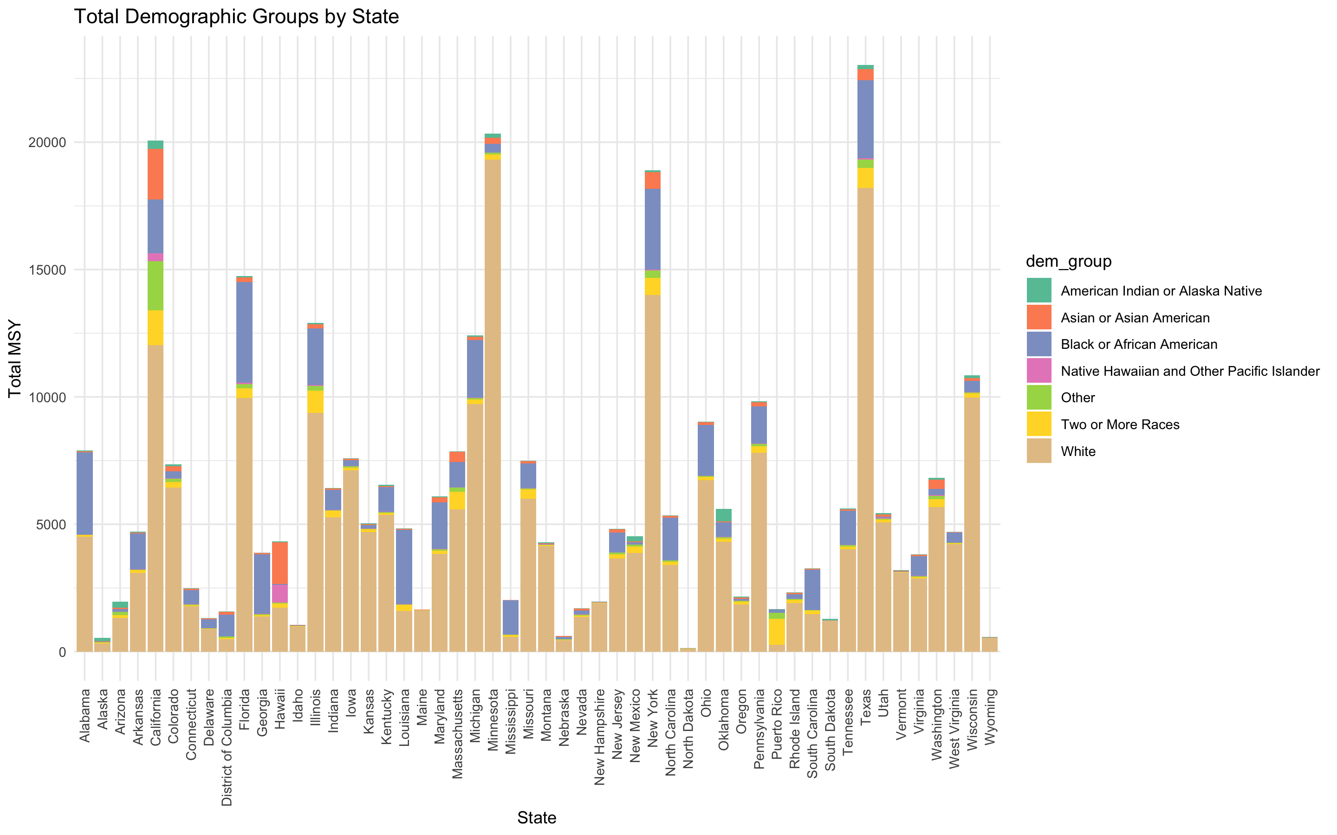
Are some racial groups more engaged in volunteer activities within specific states?

Slide 8
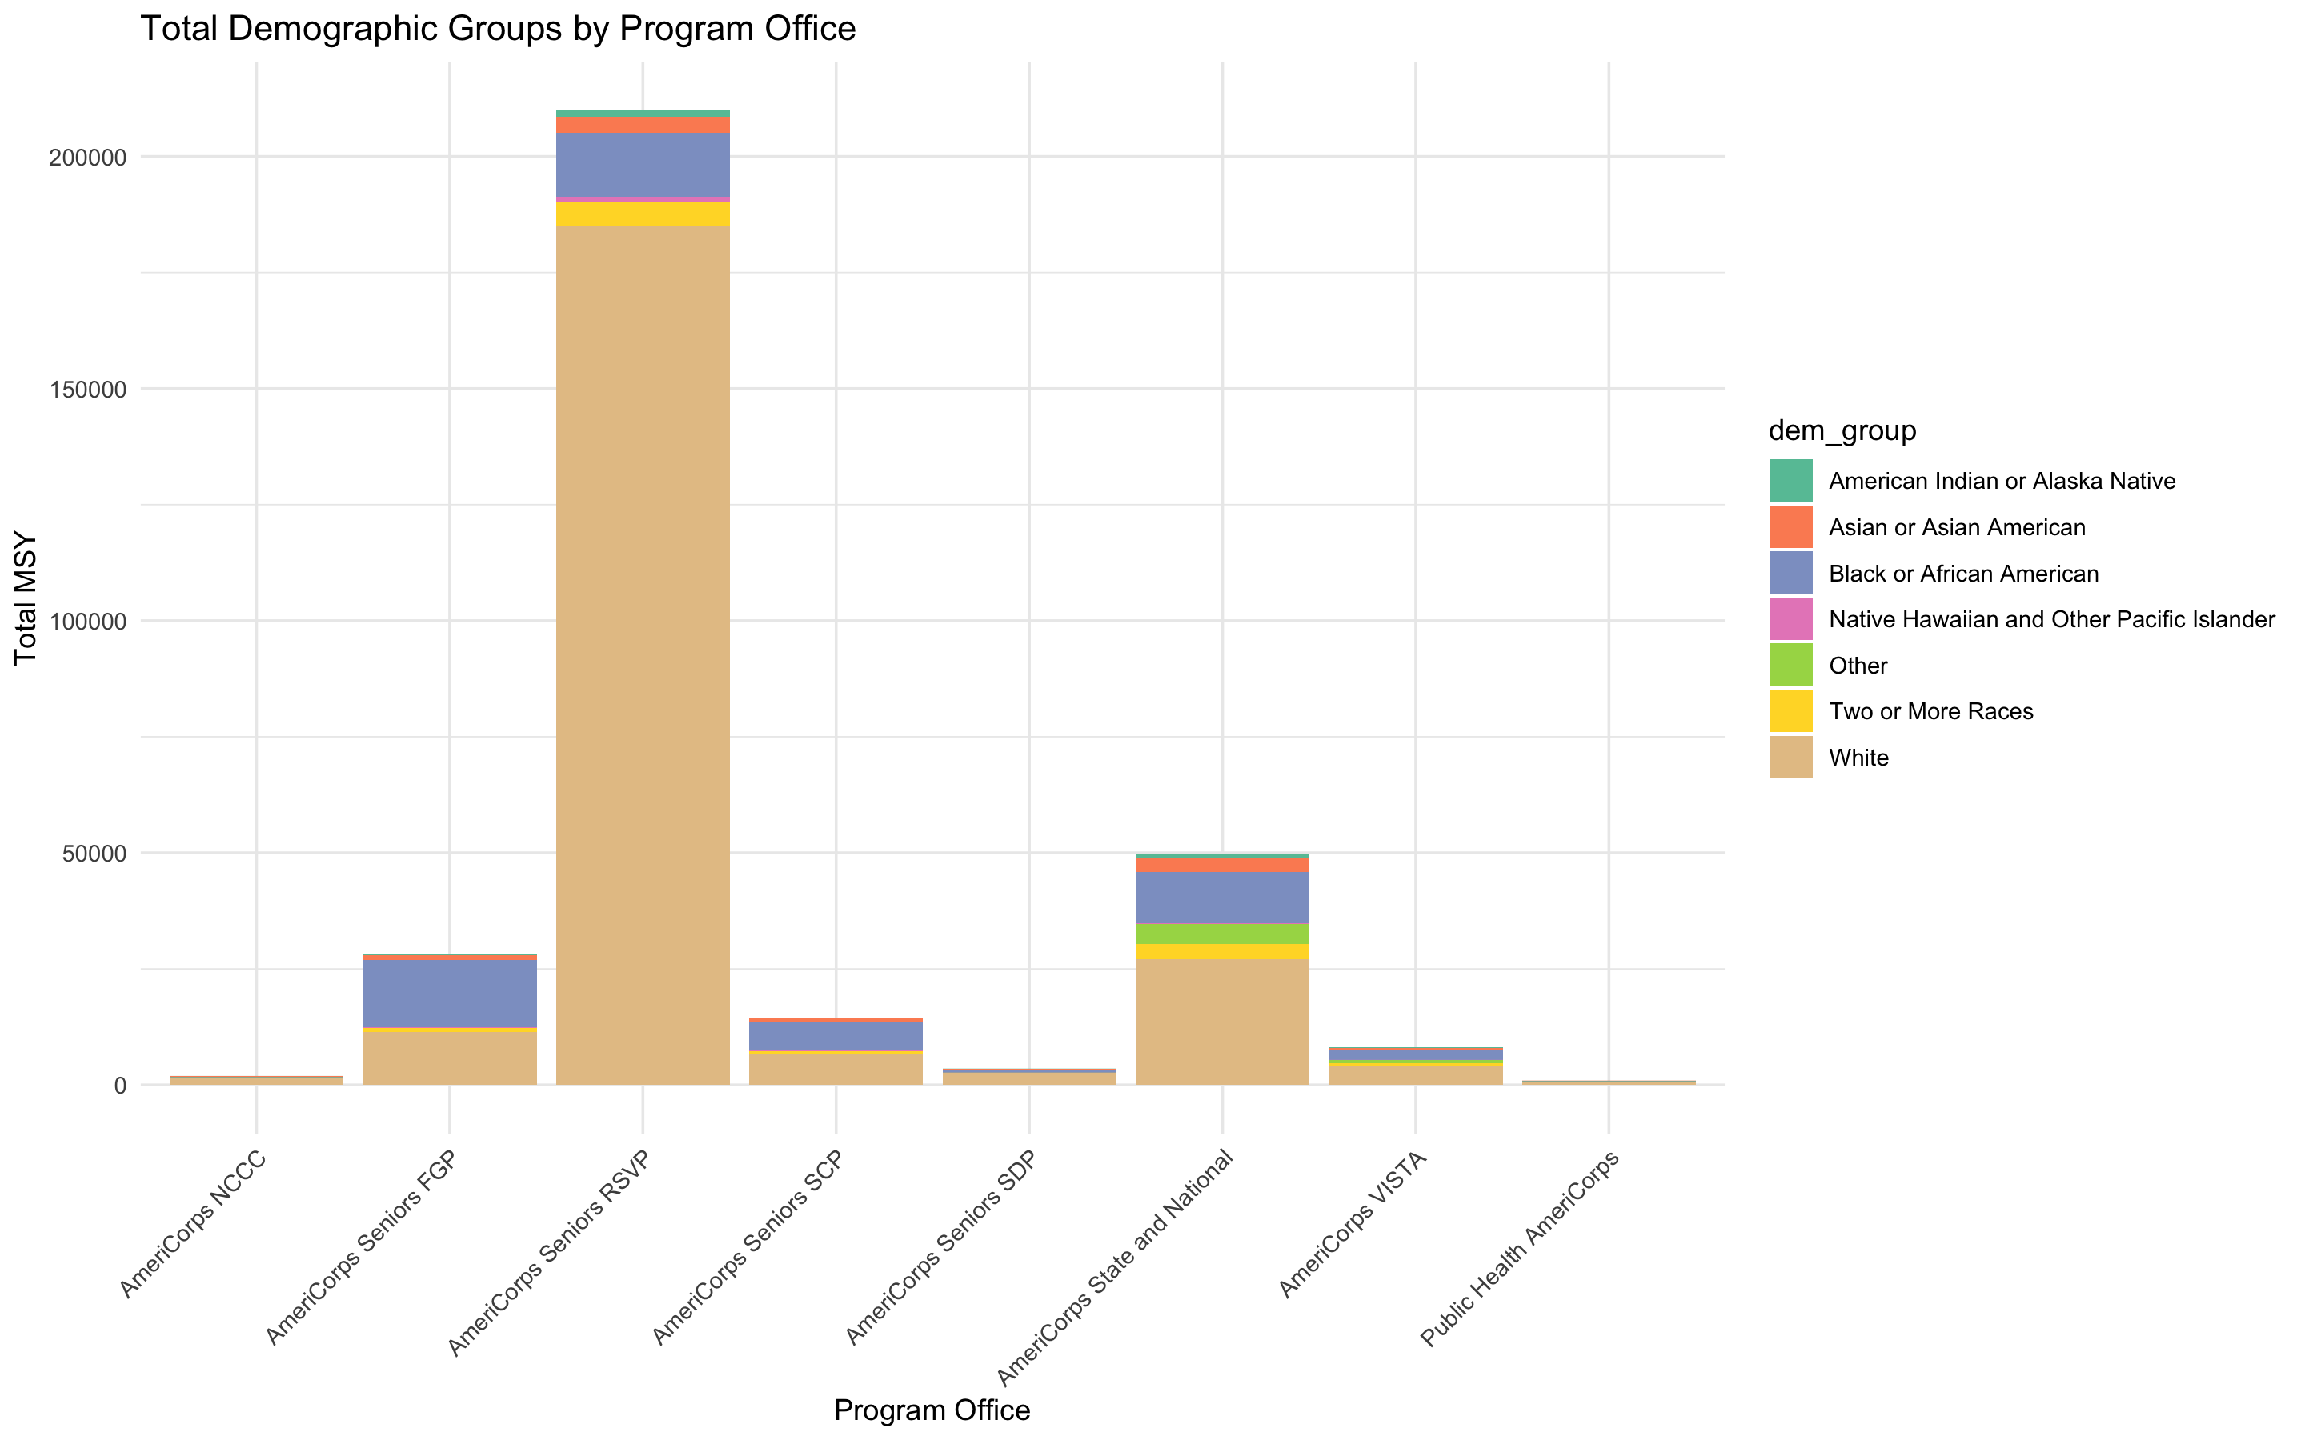
Which program offices are most effective in engaging a diverse range of participants?

Slide 9
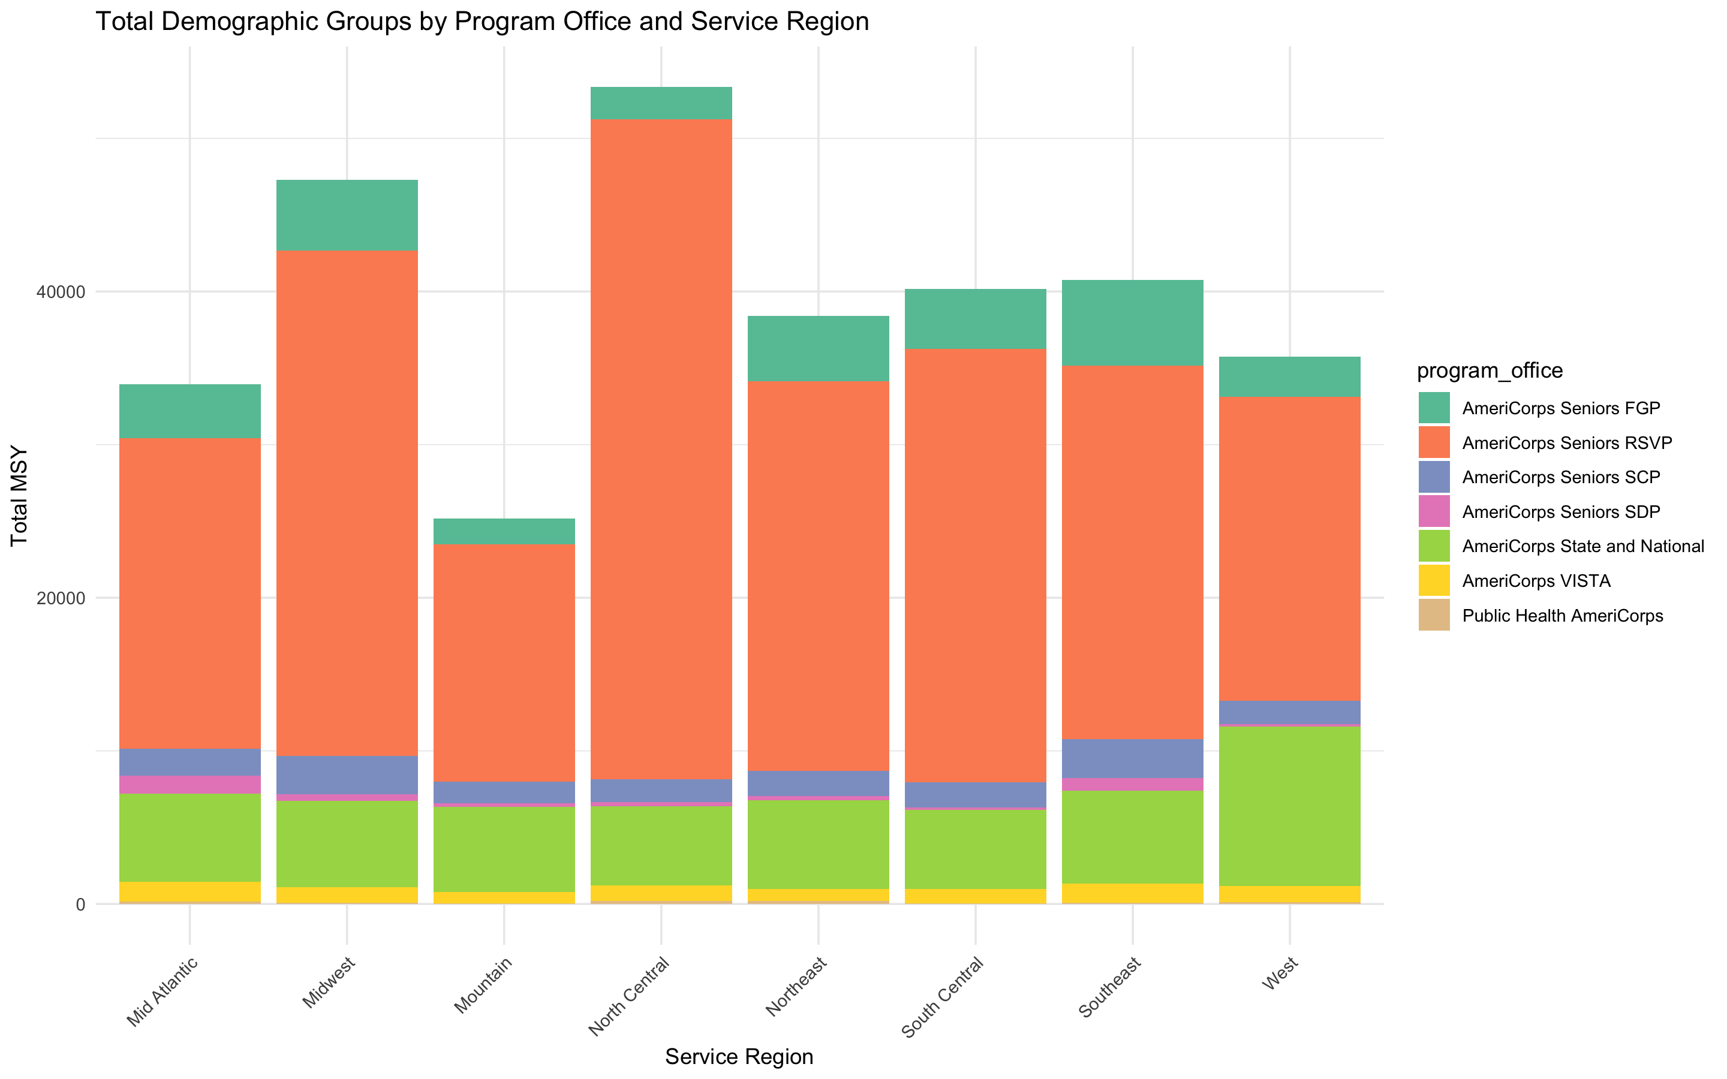
How do participation rates compare between different programs within the same service region?

Slide 10
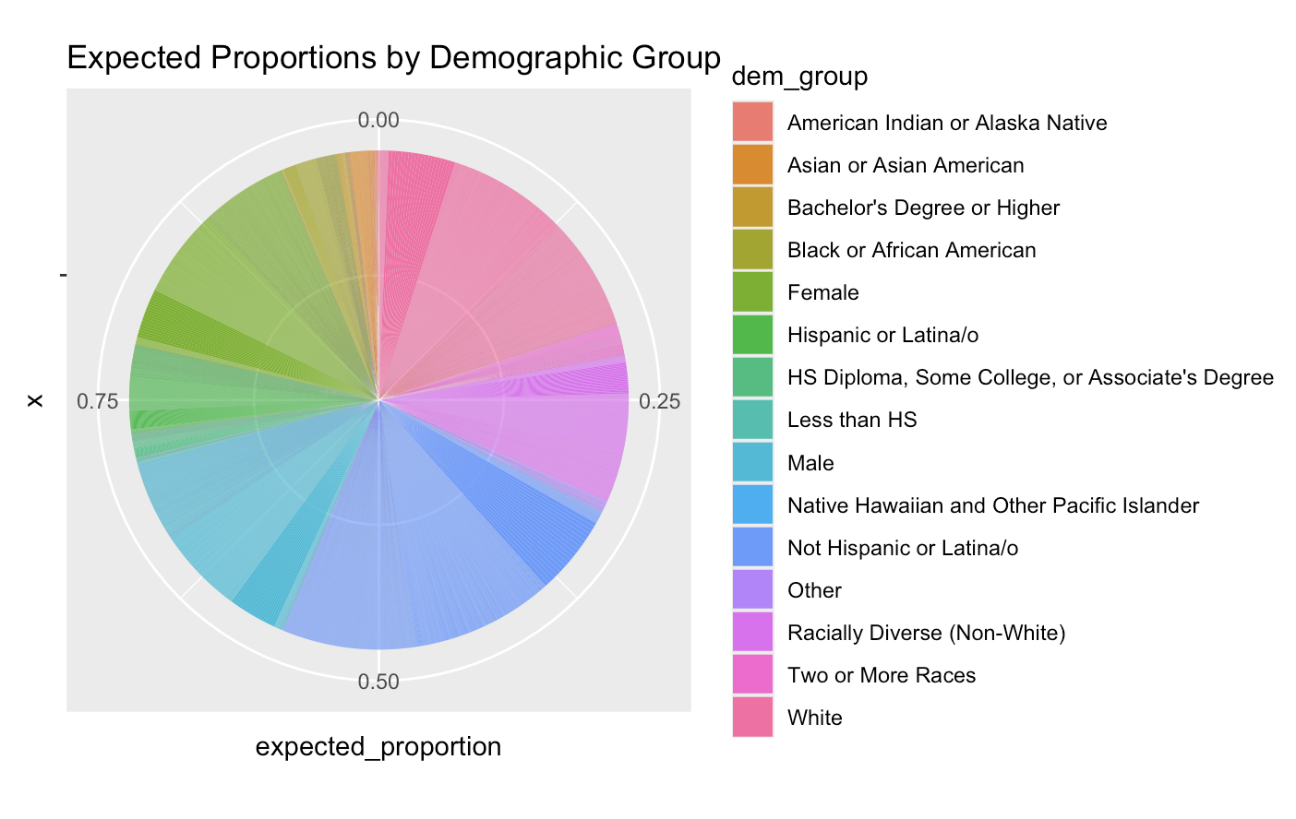
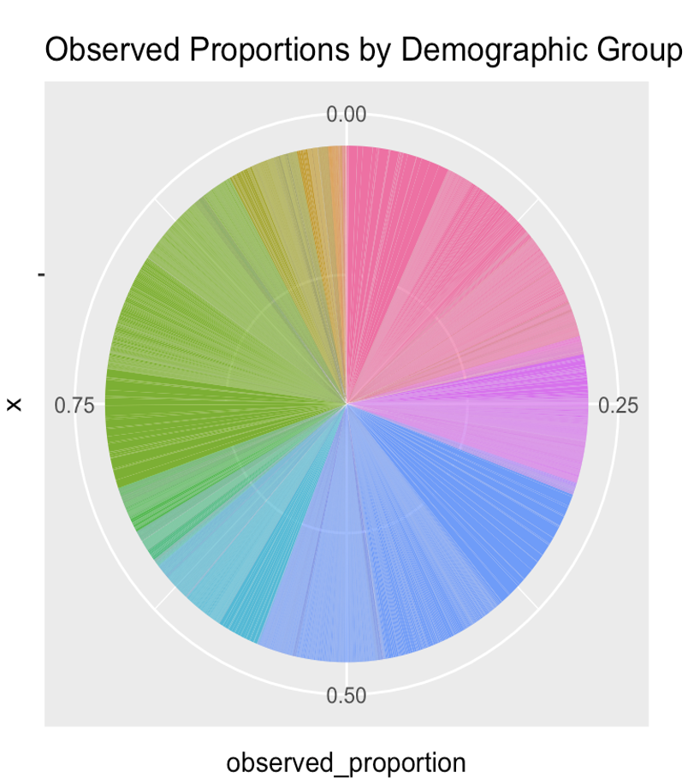
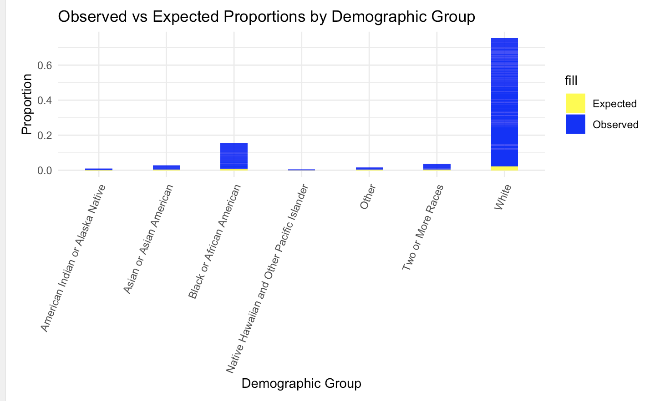
How does the representation of different demographic groups compare to their proportions in the general population?
White and Female demographic groups appear to have larger slices in the observed graph compared to the expected graph, indicating that these groups are overrepresented in the program.
Asian or Asian American and American Indian or Alaska Native groups have smaller slices in the observed graph compared to the expected graph, indicating underrepresentation.
The Bachelor's Degree or Higher group, which is likely associated with education levels, also has a noticeably larger slice in the observed chart, suggesting overrepresentation of more highly educated individuals.
Proportional Representation:
If the two charts had identical slices, it would mean that AmeriCorps’ participant demographics perfectly reflect the general population. However, differences in slice sizes show where AmeriCorps’ recruitment and participation differ from the general population's demographic makeup.
Conclusion of this check :
The expected proportions graph shows how AmeriCorps participants would be distributed across demographic groups if they reflected the general population.
The observed proportions graph shows how participants are actually distributed, revealing that certain groups (e.g., White, Female, and higher education) are overrepresented, while others (e.g., Asian or Asian American, American Indian or Alaska Native) are underrepresented.

Slide 11
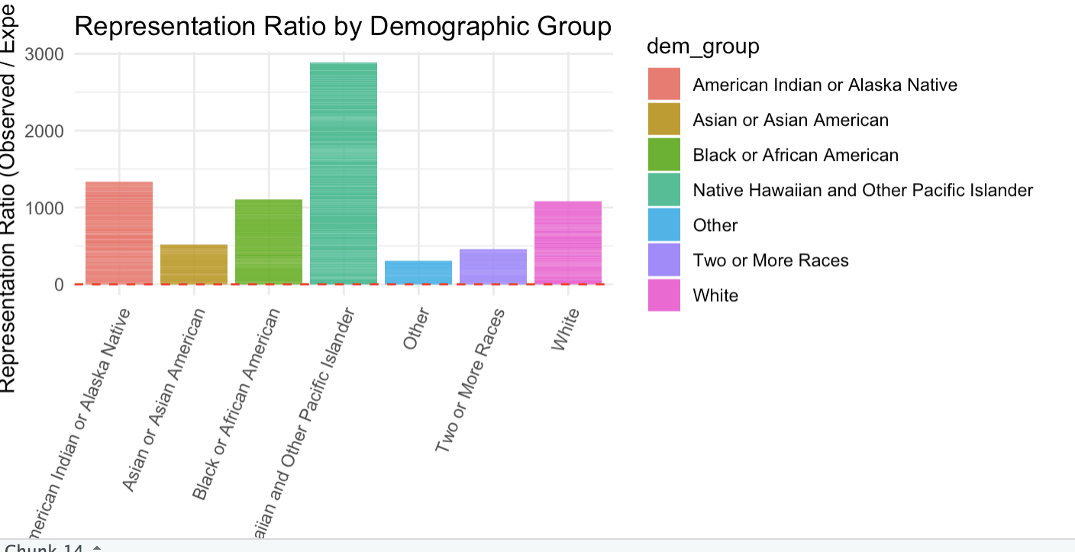
Which groups are overrepresented or underrepresented in AmeriCorps?
Key Observations:
Native Hawaiian and Other Pacific Islander Group:
This group has a very high representation ratio, significantly exceeding the expected value with a ratio around 3000. This indicates that Native Hawaiian and Other Pacific Islander participants are overrepresented in the AmeriCorps program compared to their expected population proportion.
American Indian or Alaska Native:
This group is also overrepresented, with a representation ratio over 1000, showing that the number of participants from this group far exceeds the expected value based on population size.
Black or African American and White Groups:
These groups also show overrepresentation, with ratios around 1000 and 700, respectively. They are engaged in AmeriCorps at a higher rate than expected, but not as dramatically as the Native Hawaiian group.
Asian or Asian American:
This group has the lowest representation ratio, indicating that the observed number of volunteers from this demographic is much lower than expected based on population data. This suggests underrepresentation in AmeriCorps for this group.
Other Demographic Groups (e.g., Two or More Races, Other):
Groups like Two or More Races and Other have representation ratios that are closer to 1, meaning their participation in AmeriCorps is closer to the expected level based on their population proportion.
Conclusion:
The graph highlights significant overrepresentation for certain groups, particularly the Native Hawaiian and Other Pacific Islander and American Indian or Alaska Native groups.
Black or African American and White participants are also overrepresented but to a lesser extent.
On the other hand, Asian or Asian American individuals are underrepresented, meaning that their participation in AmeriCorps is lower than would be expected based on their population size.
This visualization suggests that AmeriCorps may need to focus more on outreach or engagement with underrepresented groups, such as Asian or Asian American populations.

Slide 12
Conclusion
AmeriCorps consists of
AmeriCorps aims for its volunteers to be representative both of the nation and of the communities it serves
The data seems to indicate it is not quite reflective

